Slide 1
Verification and Validation of a Design-by-Contract Layered Library Management System
Anil Manyam (Student Id: 202483873)
Sadia Alam (Student Id: 202295835)

Slide 2
01
Table of Contents
Introduction to V&V in LMS
02
Literature Review: State of the Art
03
System Architecture of LMS
04
Methodology of V&V Strategy
05
Result & Discussion
06
Conclusion & Future Work

Slide 3
Introduction to V&V in LMS
01

Slide 4
The Growing Complexity
Complexity in Modern Software
Limitations of Traditional Testing
Modern systems face increasing complexity; correctness, reliability, and robustness are paramount, especially in applications like Library Management Systems (LMS).
Traditional testing may not fully ensure compliance with formal specs; software verification and validation (V&V) techniques are gaining importance.

Slide 5
Project Focus : Design by Contract
01
02
Core Methodology
Layered Architecture
This project emphasizes Design by Contract (DbC) for ensuring software correctness in designing, verifying, and validating an LMS.
The system uses a layered architecture for modular design and separation of responsibilities. Contracts are applied to make component roles explicit.

Slide 6
Hybrid Approach: Formal + Practical
Evaluation Strategy
A combination of formal verification and practical validation techniques is used to evaluate the system’s correctness and reliability.
Modeling and Verification
Critical behaviors like borrowing/returning books are formally modeled using Alloy and verified for logical consistency.
Runtime Validation
PyContracts is used in the Python codebase to enforce contracts during runtime. Unit tests based on specifications are developed using pytest.

Slide 7
Literature Review: State of the Art
02

Slide 8
The Growing Complexity
State of the Art in Software Verification and Witness Validation (Beyer, 2024)
Fault Localization on Verification Witnesses (Beyer et al., 2024)
SV-COMP 2024: Largest to date with 76 tools from 34 teams.
Benchmarked on 30,300 C and 587 Java programs.
New witness validation track with YAML format (v2.0).
Focus on memory safety, reachability, overflows, termination.
Emphasizes result validation and transparency (data on Zenodo).
Complements other competitions: VerifyThis, TermCOMP, Test-Comp.
Proposes reducing violation witnesses to only error-relevant statements.
Uses SMT-based methods (MaxSAT, MinUNSAT) for fault localization.
Implemented in CPAchecker and new tool Flow.
Evaluated on 21,356 witnesses from SV-COMP 2023.
Achieved 25% average size reduction and 34% more successful validations.
Bridges debugging techniques with formal verification for better validation.

Slide 9
The Growing Complexity
Runtime Verification – RV 2024 (Ábrahám & Abbas, 2025)
Design by Contract in Python (Andrea, 2025)
Held in Istanbul, Oct 15–17, 2024; featured 18 peer-reviewed papers.
Topics: cyber-physical systems, temporal logics, neural networks, distributed systems.
Keynote: Bonakdarpour on Distributed Verification with Imperfect Monitors.
Focus on hybrid methods and stream-based monitoring.
Tool showcase emphasized practical applications.
Highlights how runtime verification complements static analysis in real-time systems.
Proposes native __invariant__() method for automatic class invariant checks.
Called before and after public method calls, ensuring object consistency.
Inspired by DbC support in Eiffel, D, Ada.
Aims to replace fragile decorators/metaclasses with a built-in, opt-in mechanism.
Useful for stateful systems like simulations and financial apps.
Backed by a C-extension prototype and discussion on Python-Dev.

Slide 10
System Architecture of LMS
03

Slide 11
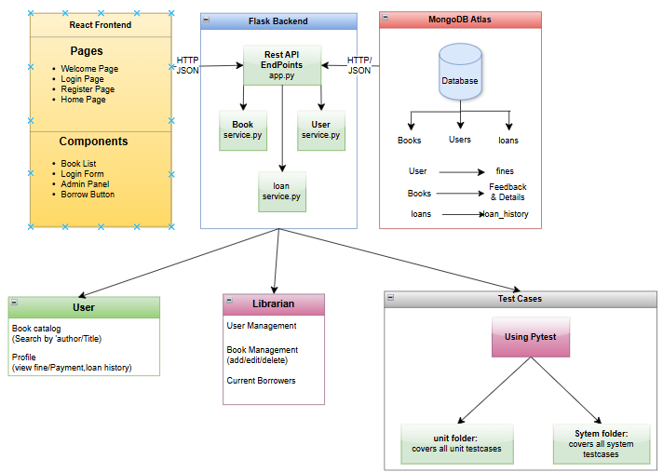
Three-Tier Layered Architecture
Service Layer (Flask)
Middleware exposing a REST API; applies business logic, validates inputs using DbC (icontract), and handles communication.
Presentation Layer (React.js)
Data Layer (MongoDB Atlas)
Provides a responsive, component-based UI; handles user interactions like searching for books or initiating loans.
Cloud-based NoSQL database storing collections for users, books, loans, loan history, and feedback. Schema-less design.

Slide 12
Data Persistence & Communication
MongoDB Flexibility
Enhancements
Frontend Interaction
Offers document-oriented storage and global accessibility. Collections include users, books, loans, loan_history, and book_feedback.
Indexes on fields like username and book_id ensure fast retrieval; replica sets enhance fault tolerance/availability.
React frontend interacts via RESTful APIs retrieves from the database based on requests/functions.

Slide 13
Testing Strategy via Python MagicMock
Mocking Collections
Backend Focus
Benefits of Architecture
MongoDB collections are mocked using Python’s MagicMock for isolated, controlled testing, avoiding alteration of real data.
Focus on backend verification/validation, designed to work with a frontend built potentially using React communicating through APIs.
Supports end-to-end testing aligned with web development practices, making the LMS easier to extend and maintain.

Slide 14
Methodology of V&V Strategy
04

Slide 15
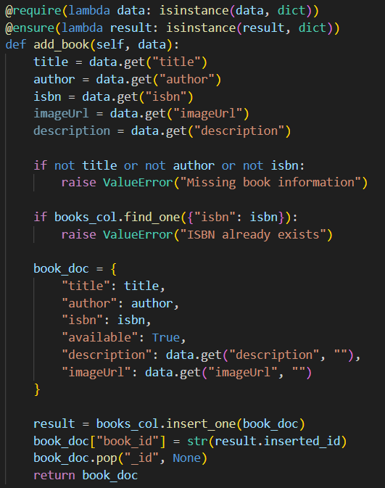
4.1 Unit Testing 🔍 Purpose: Confirm that core components (book management, user operations, loan processing) work as intended.
Admin Unit Test: test_add_book_success
Step 1: Identify the Function
Function under test: BookService.add_book(data: dict)
Allows librarians to add new books to the catalog
Prevents duplicates by checking ISBN or title
Essential for maintaining a clean and unique book collection
Step 2: Analyze Dependencies
Depends on books MongoDB collection
Uses:
find_one to check for existing books
insert_one to add new book entries
All external calls are mocked to avoid real DB interaction
Step 3: Isolate the Function
MongoDB operations are simulated using MagicMock
monkeypatch replaces actual collections with mocks
find_one returns None; insert_one returns dummy ObjectId

Slide 16
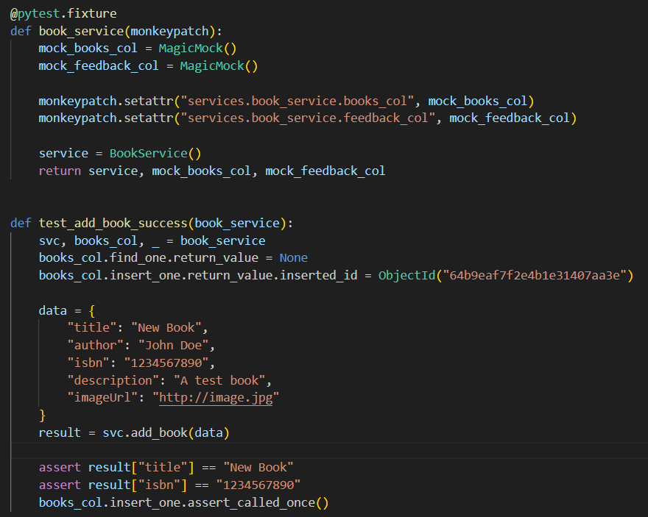
4.1 Unit Testing 🔍 Purpose: Confirm that core components (book management, user operations, loan processing) work as intended.
Admin Unit Test: test_add_book_success
Step 4: Write and Run the Test
Call add_book() with sample valid input
Assert the result includes expected title and ISBN
Confirm that insert_one was called exactly once
Step 5: Automate and Repeat
Test stored in: tests/test_book_service.py
Run using: pytest -k test_add_book_success -v
Part of CI pipeline to ensure future stability
No interaction with real data ensures safety and repeatability

Slide 17
Test Case 1: test_add_book_success (Librarian)
05
04
03
Automation and Repetition
02
01
Test Execution
Located in 'tests/test_book_service.py', run individually or as part of automated suite.
Function Isolation
behavior of mock database, find_one mocked to return None, insert_one returns successful insertion. Checks output, confirms insert_one was called once.
Dependencies
unittest.mock.MagicMock used, pytest.monkeypatch overrides services.book_service.books_col. Mock setup simulates absence of duplicate.
Function Under Test
Relies on the books MongoDB collection (find_one, insert_one). Mocked to prevent interacting with real database contents.
BookService.add_book(data: dict), allows librarians to add books. Checks for duplicates and inserts if none are found.

Slide 18
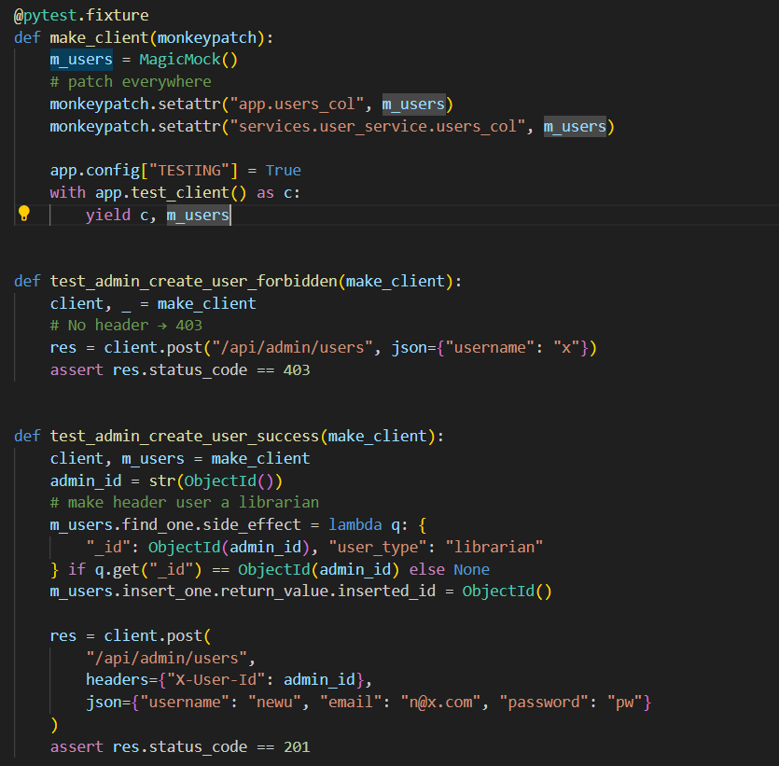
4.2 System Testing 🔍 Purpose: Validate system behavior through real API endpoints using Flask’s test_client and mocked MongoDB collections.
Create User API (/api/admin/users)
Step 1: Key Decision Points
Authorization: Only admins (valid X-User-Id) allowed
Input Validation: Required fields (username, email, password) must be valid
Uniqueness Check: Username/email must not already exist
Insert Outcome: DB insertion must succeed without error
Header Check: Request must include proper admin ID header
Step 2: Input Partitions
Authorization:
Authorized admin
Unauthorized or missing header
Data Validity:
All fields valid
Missing fields (e.g., password)
Invalid format (e.g., bad email)
Uniqueness:
Unique username/email
Duplicate username/email
Invalid/fake user ID

Slide 19
4.2 System Testing 🔍 Purpose: Validate system behavior through real API endpoints using Flask’s test_client and mocked MongoDB collections.
Create User API (/api/admin/users)
Step 3: Test Case Specs
1. Successful Creation
Conditions: Authorized admin + valid input + unique data
Outcome: 201 Created, user added to DB
2. Duplicate Data
Conditions: Authorized admin + valid input + duplicate email/username
Outcome: 400/409 Error, user rejected, no DB insert
Step 4 – Generate Concrete Test Cases
Test Case 1 – Successful Creation:
Authorized admin, valid data, unique email/username
Expected: 201 Created, user stored in DB
Test Case 2 – Duplicate Email:
Authorized admin, valid data, email already exists
Expected: 409 Conflict, user not added
Full suite of ~20 system tests implemented in Backend/tests/system/

Slide 20
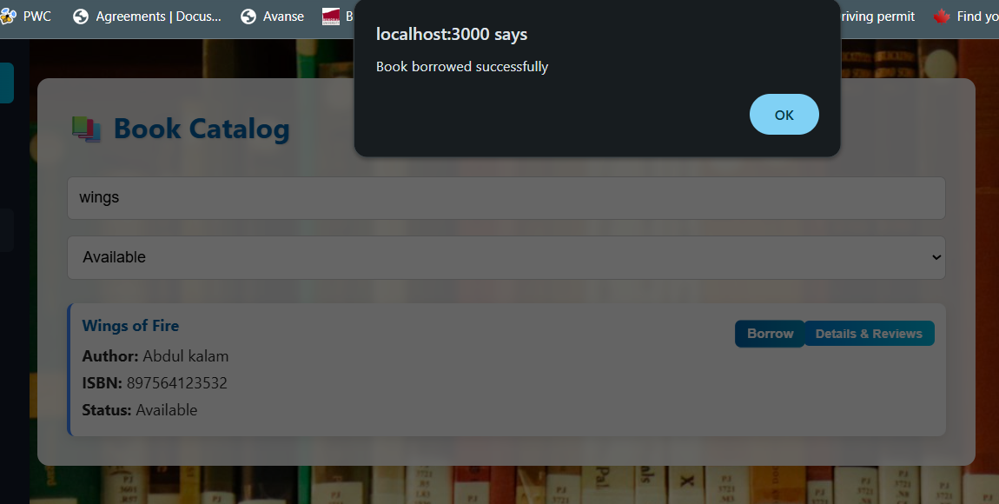
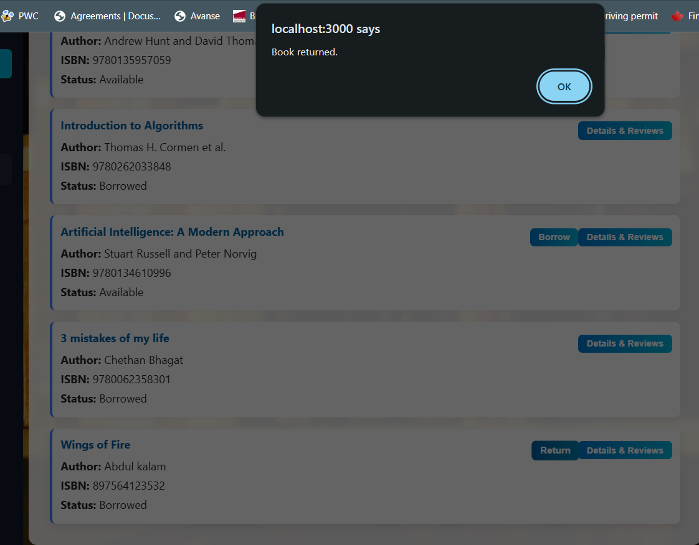
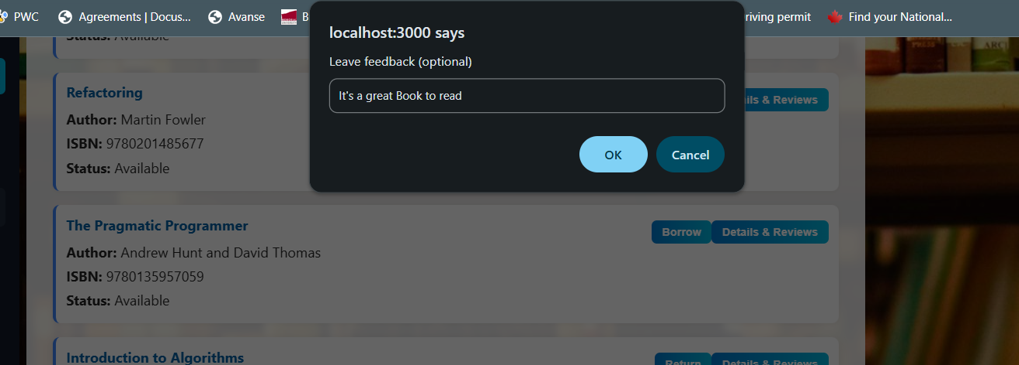
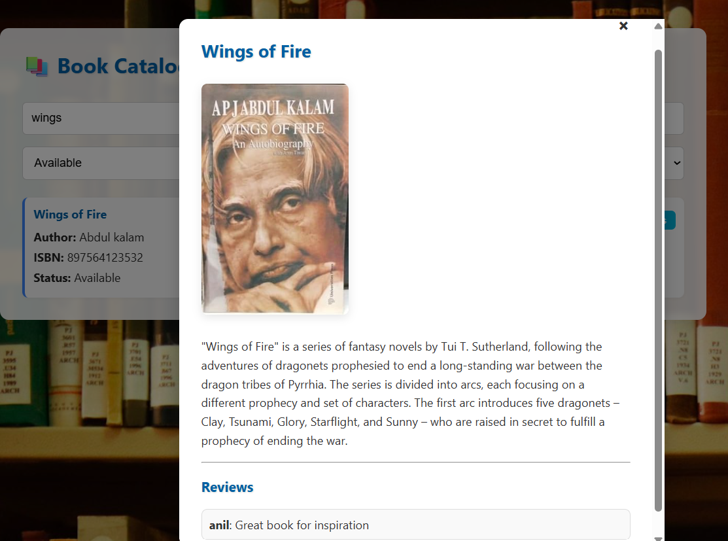
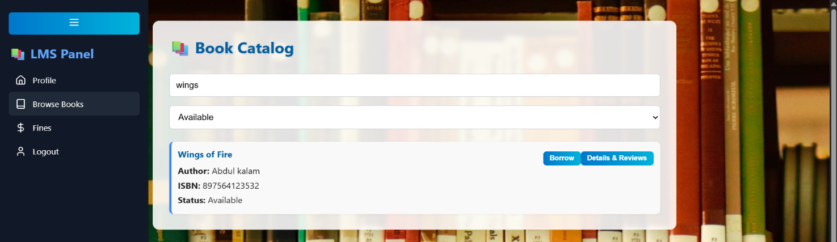
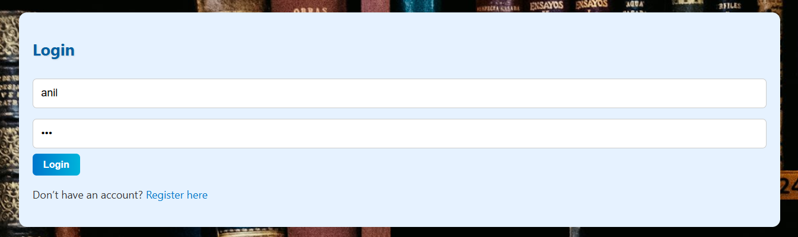
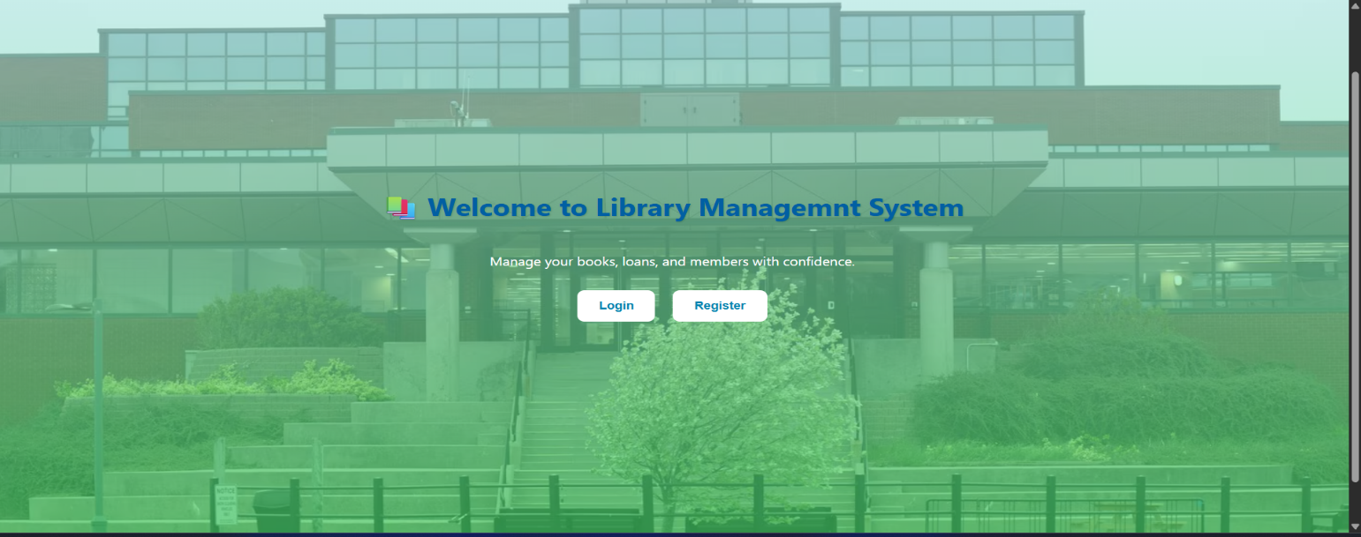
4.3 Exploratory Testing 🔍Performed hands-on, unscripted testing across the Library Management System UI
Example User Journey (Anil)
Landing Page: Welcoming, clean interface with Login/Register options
Login: User logs in with valid credentials
Search Book: Searched for "Wings of Fire", results update dynamically
View Details: Viewed book info and user reviews in a modal window
Borrow Book: Successful borrow, backend updates reflected in UI
Return Book: Returned book with confirmation message
Leave Feedback: Submitted feedback via popup, instantly added to reviews
No UI errors, broken transitions, or functional issues encountered
Verified full frontend-backend integration and user experience
Similar exploratory tests done for user management, fine payments, etc.
Complements unit + system tests for a robust V&V strategy

Slide 21
Results & Discussion
05

Slide 22
Results & Discussion
Result & Discussion
The system was tested using unit, system, and exploratory methods.
Unit Testing
35 test cases passed
Covered book addition, user registration, borrowing, returns, and fines
Early issues (headers, ObjectId) were fixed
System Testing
Verified API routes like user creation, loans, fines, and feedback
Checked authorization, database updates, and error handling
Confirmed stable full-stack behavior
Exploratory Testing
Simulated real user actions: login, search, borrow, return, review
No errors found, UI and backend worked smoothly
Conclusion
The system is stable, user-friendly, and ready for real-world use

Slide 23
Conclusion & Future Work
06

Slide 24
Conclusion & Future Work
Conclusion
Combined unit, system, and exploratory testing covered backend and frontend
Used mocking and test scenarios to simulate real conditions safely
System meets all requirements — stable, user-friendly, and deployment-ready
Ongoing testing will help maintain quality and performance
Future Work
Conduct acceptance testing with real users
Plan alpha and beta releases for usability feedback
Improve test coverage:
Real-world edge cases
UI accessibility
Mobile responsiveness

Slide 25
References
07

Slide 26
List of References
[1] D. Beyer, "State of the art in software verification and witness validation: SV-COMP 2024," in International Conference on Tools and Algorithms for the Construction and Analysis of Systems, 2024: Springer, pp. 299-329.
[2] D. Beyer, M. Kettl, and T. Lemberger, "Fault Localization on Verification Witnesses," in International Symposium on Model Checking Software, 2024: Springer, pp. 205-224.
[3] E. Ábrahám and H. Abbas, Runtime Verification: 24th International Conference, RV 2024, Istanbul, Turkey, October 15–17, 2024, Proceedings. Springer Nature, 2024.
[4] D. Evans, "Towards differential program analysis," in Proc. ICSE 2003 Workshop on Dynamic…, 2003.

Slide 27
Thank you

